Slide 1

FinESG-GPT: A Large Language Model for ESG and Financial Analysis
Mentor: Dr . P Manasa
Team Members: Ananya Sriram, Anshita Sugandhi, P Shriya , Deepak Jhanwar, Ansh Sugandhi

Slide 2

Base Research Paper
SusGen-GPT: A Data-Centric LLM for Financial NLP and Sustainability Report Generation
Our project is built on this foundational research, which explores how AI can bridge the gap between environmental, social, and governance metrics and financial performance analysis.
The paper introduces innovative approaches to integrating ESG data with financial analysis using large language models.

Slide 3

What We're Building
Paper Summary
Our Implementation
Problems We're Solving
The research develops an AI system that analyzes ESG metrics and financial performance together, creating a unified view of sustainability and business outcomes.
We're creating a working model that helps analyze sustainability-finance relationships, making these insights accessible and actionable for real-world use.
Existing tools analyze ESG and finances separately
Lack of integrated correlation analysis
Need for accessible ESG-financial insights

Slide 4
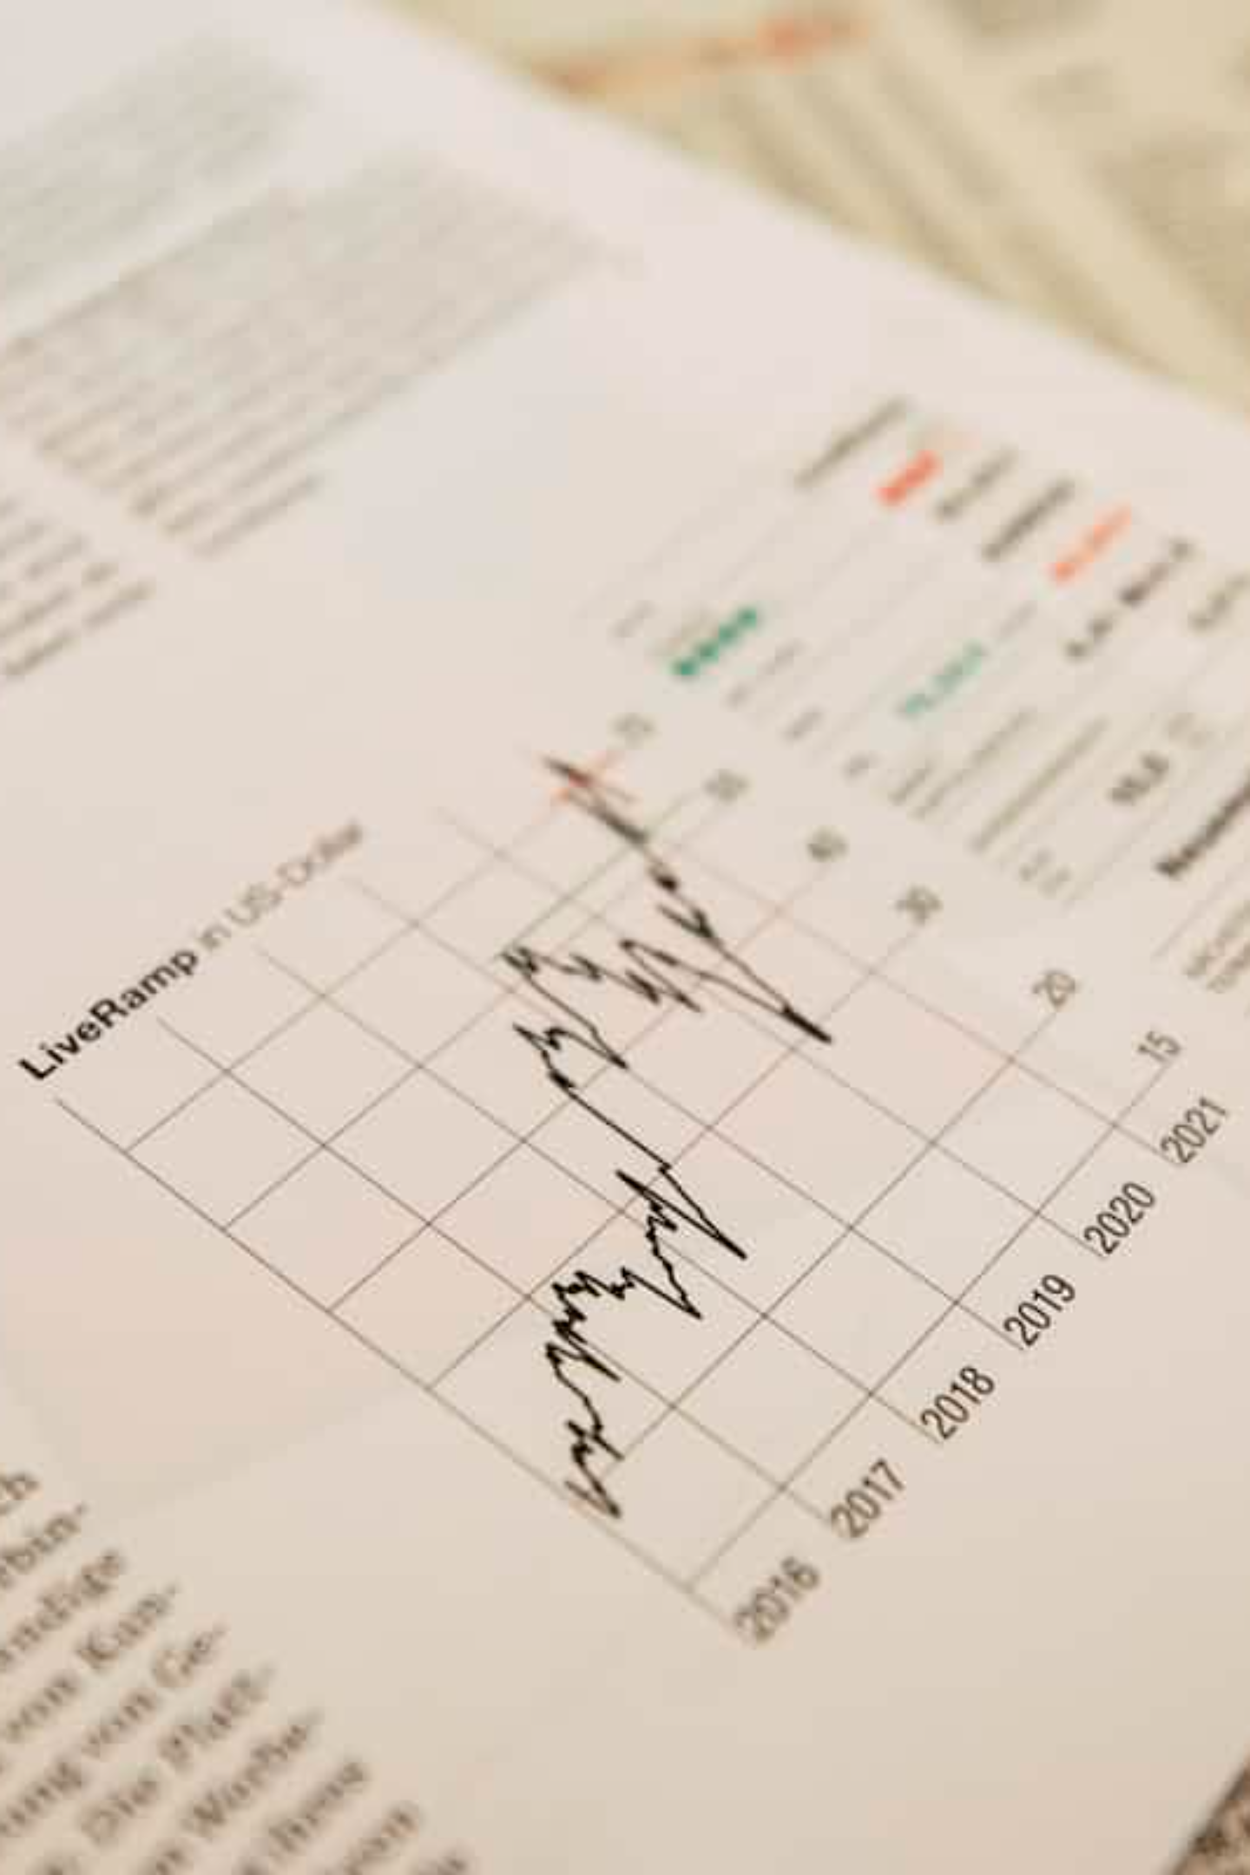
Problem Statement
Our Focus
Creating an AI system that bridges ESG metrics with financial outcomes, providing integrated analysis that reveals how sustainability drives business value.
The Core Challenge
Companies and investors struggle to understand how Environmental, Social, and Governance (ESG) initiatives actually impact financial performance in measurable ways.
Current Limitations
Separate analysis tools for ESG and financial metrics
Lack of clear correlation insights between sustainability and profits
Difficulty processing and interpreting complex ESG data

Slide 5




Who Can Use This?
Target Users
Corporate sustainability teams
Financial analysts
Investment firms
ESG consultants
How They Use It
When to Use
ESG report analysis
Input ESG data and financial metrics
Investment decision-making
Sustainability strategy planning
Compliance reporting
Get correlation analysis
Make data-driven sustainability decisions

Slide 6
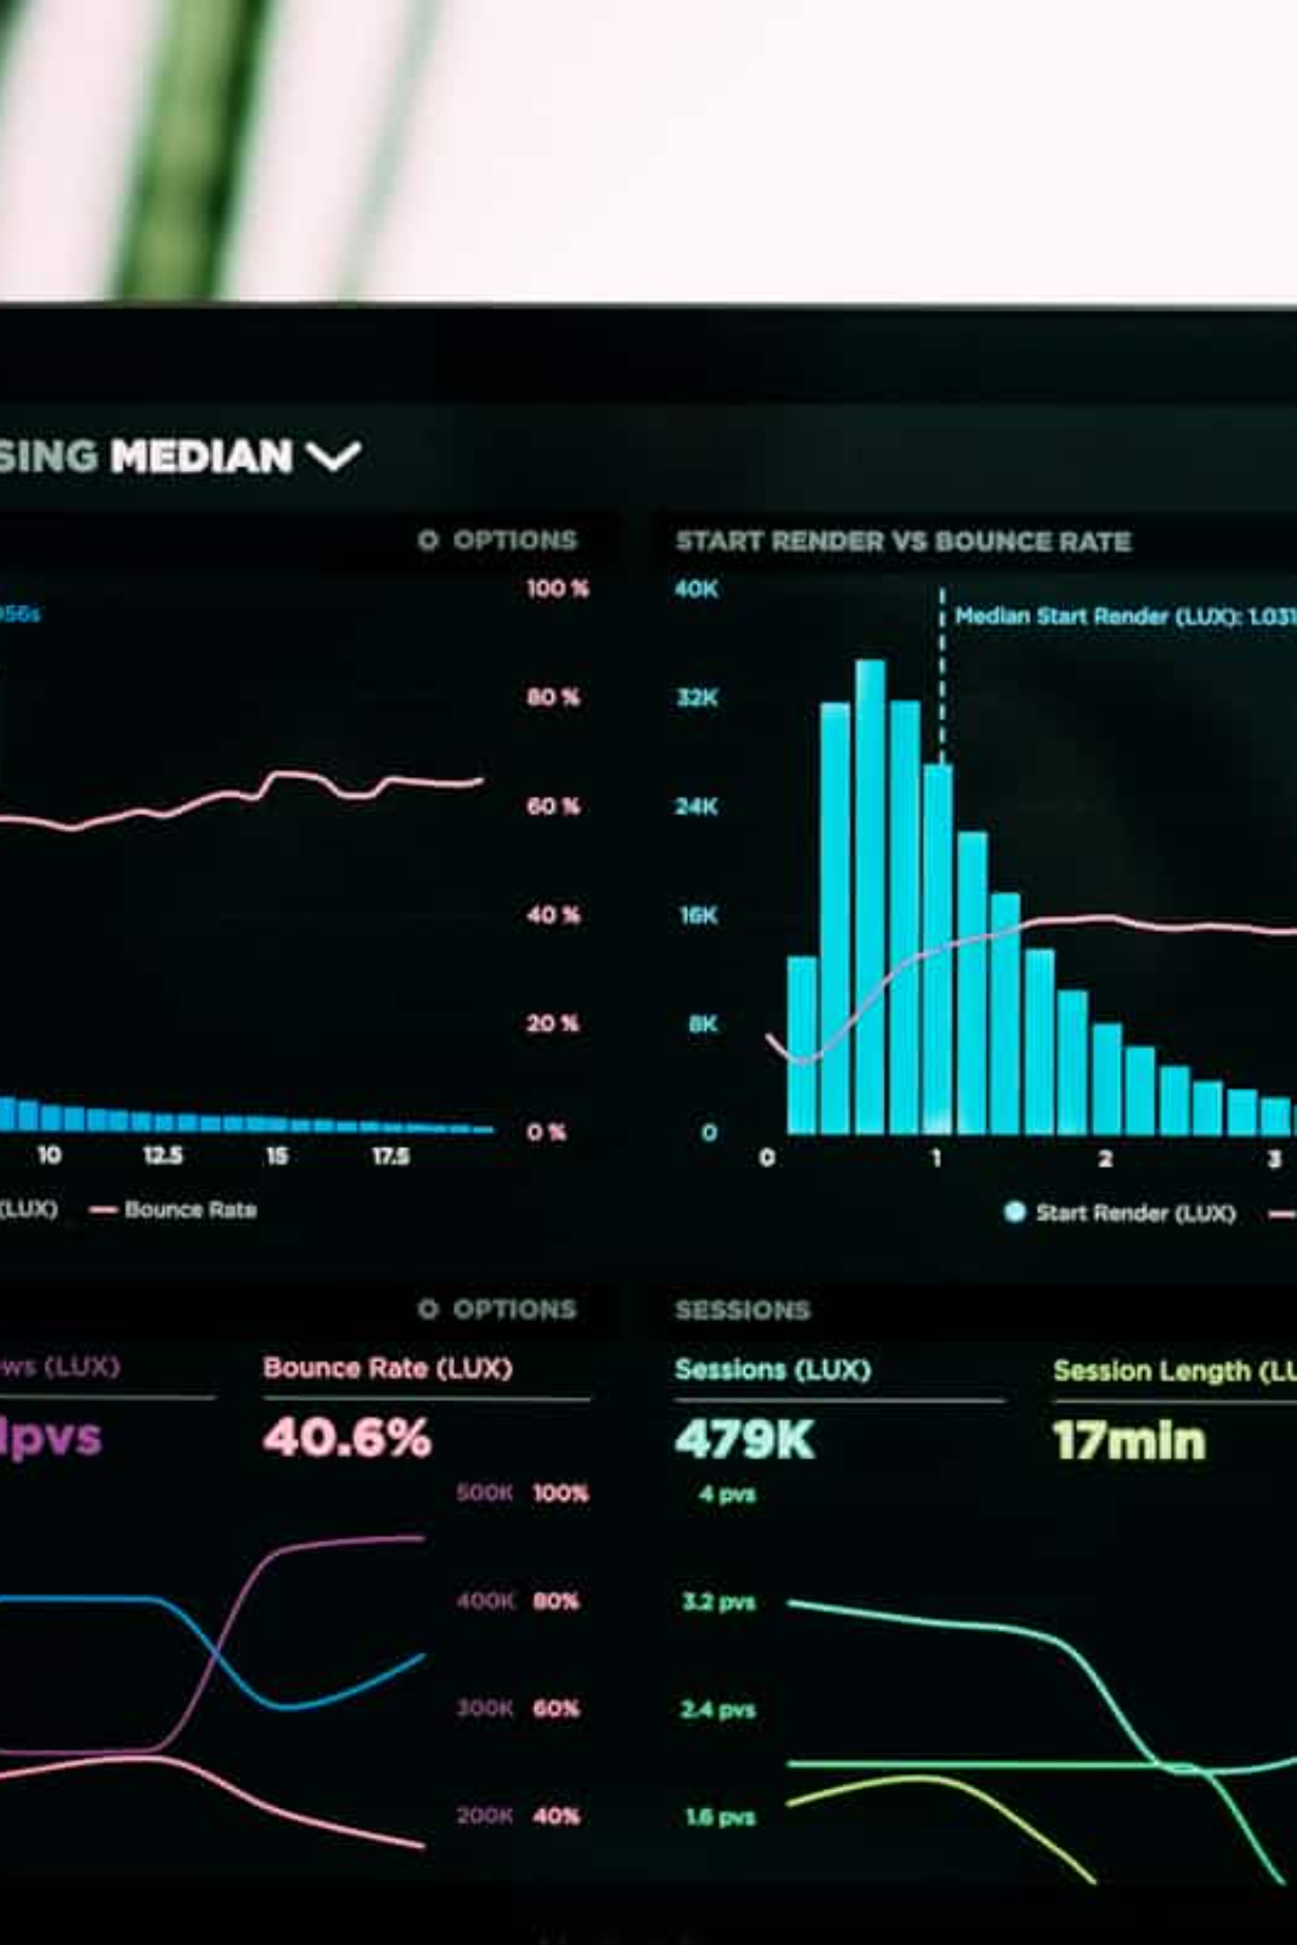
Our Solution & Expected Results
01
Implementation Approach
We're fine-tuning the FinGPT model using ESG and financial performance datasets with QLoRA technique for efficient training that requires minimal computational resources.
02
Expected Outcomes
Working model that analyzes ESG-financial correlations accurately
Clear insights on how sustainability practices affect business performance
Accessible tool that doesn't require expensive hardware or cloud resources
Our approach balances powerful analysis capabilities with practical accessibility, making advanced ESG-financial insights available to organizations of all sizes.

Slide 7
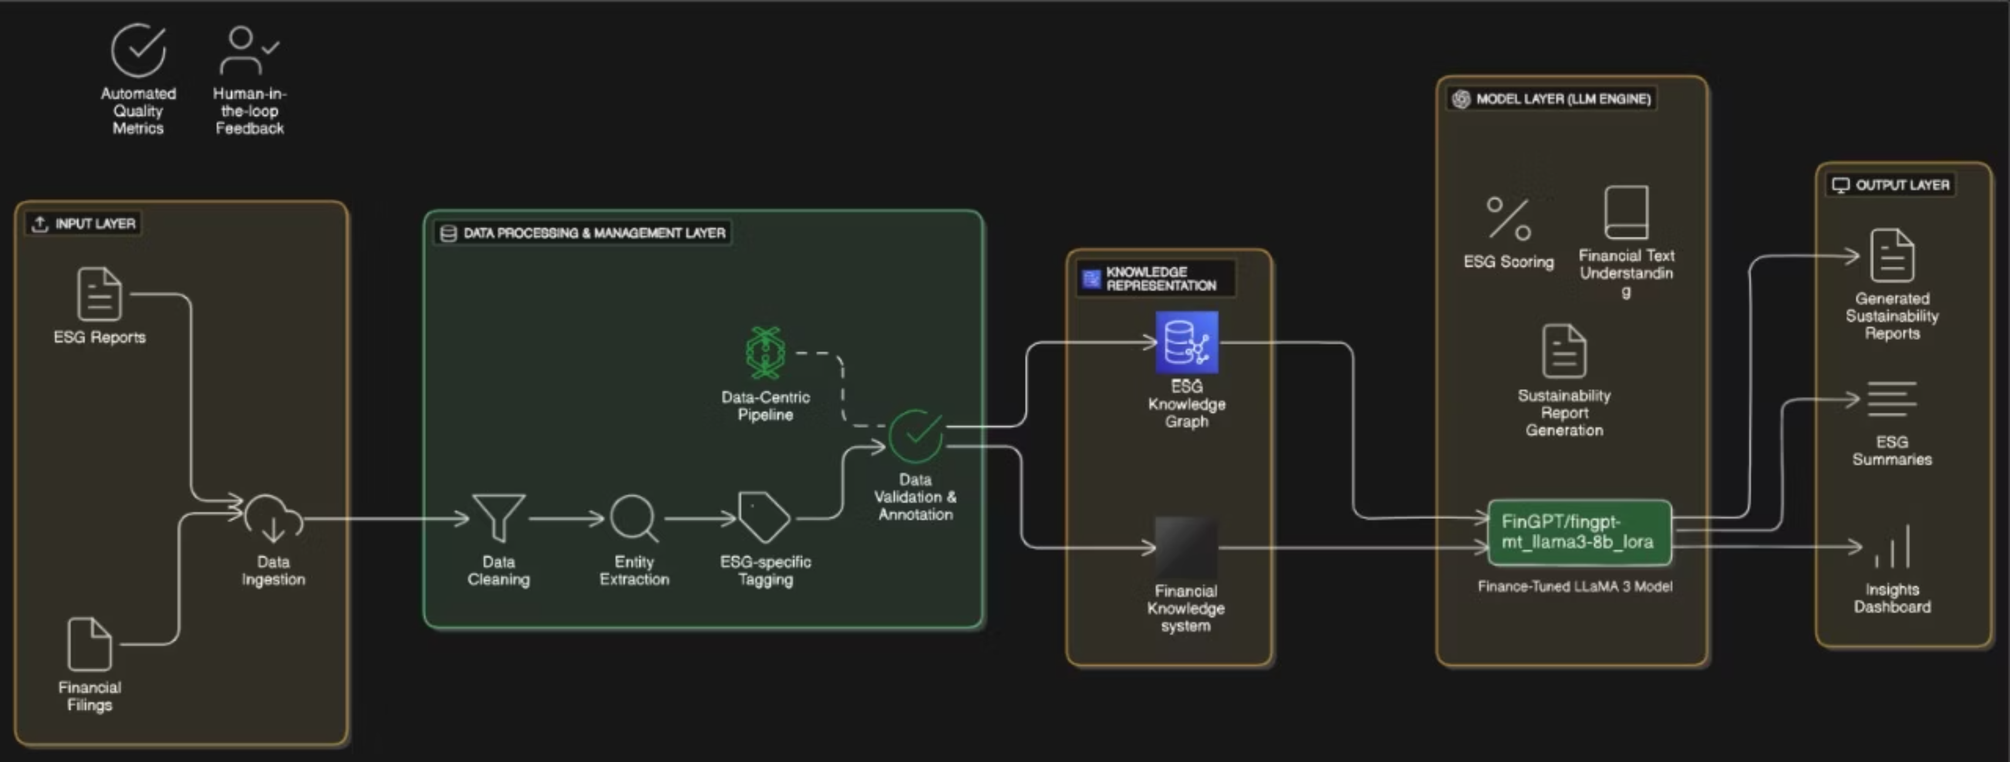
System Architecture

Slide 8
System Architecture Working
Our system architecture provides comprehensive correlation analysis between ESG metrics and financial performance, delivering actionable insights through a robust data pipeline.
Data Ingestion Layer
Collects diverse ESG data (environmental impact, social responsibility, governance)
Gathers financial metrics (revenue, profit, market data)
Preprocessing Modules
Sources: internal and external.
Cleans, normalizes, and transforms raw data
Ensures consistency and quality for analysis and feature engineering.
FinGPT Model Integration
Fine-tuned FinGPT model processes refined data
Leverages NLP and analytical capabilities
Identifies complex relationships between ESG factors and financial outcomes.
Analysis Engine
Conducts deep correlation analysis
Quantifies impacts and identifies key drivers.
Output Generation
Synthesizes findings into clear, actionable insights
Produces correlation reports, sustainability dashboards, and predictive analytics.

Slide 9

Selected Model
FinGPT
(fingpt-mt_llama3-8b_lora)
Why This Model?
Pre-trained specifically on financial data and terminology
Understands complex financial concepts and relationships
Efficient 8 billion parameter architecture
Supports LoRA fine-tuning for customization
Key Features
Built on the robust LLaMA3 architecture, designed for financial NLP tasks, and completely open-source for transparency and accessibility.

Slide 10

Datasets & Progress So Far
Datasets Used
ESG and Financial Performance Dataset (Kaggle)Contains comprehensive company ESG metrics paired with key financial indicators including revenue, profit margins, and growth rates.
Additional Financial NLP DatasetsSupplementary datasets for balanced training across various financial analysis tasks.
Work Completed
✓ Created comprehensive system architecture diagram
✓ Identified and gathered relevant datasets from reliable sources
✓ Preprocessed datasets for model compatibility
✓ Set up development environment with necessary libraries

Slide 11
Next Steps
Model Fine-Tuning
Interface Development
Apply QLoRA technique to efficiently fine-tune FinGPT on our ESG-financial datasets
Build an intuitive analysis dashboard for easy interaction with the model
1
2
3
4
Training & Testing
Real-World Validation
Train the model and conduct comprehensive performance evaluation with validation metrics
Test with actual ESG reports to ensure practical applicability and accuracy

